Slide 1
Object Detection

Slide 2
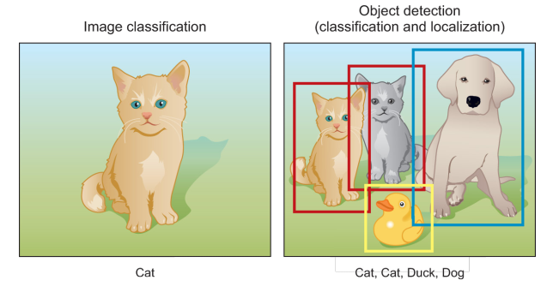
Object Detection
Object detection is a computer vision task that involves both main tasks:
1) localizing one or more objects within an image, and
2) classifying each object in the image.

Slide 3
Object Detection
This is done by drawing a bounding box around the identified object with its predicted class.
This means that the system doesn’t just predict the class of the image like in image classification tasks.
It also predicts the coordinates of the bounding box that fits the detected object.
It is a challenging computer vision task because it requires both successful object localization in order to locate and draw a bounding box around each object in an image, and object classification to predict the correct class of object that was localized.

Slide 4
Object Detection
Object detection is widely used in many fields.
For example, in self-driving technology, we need to plan routes by identifying the locations of vehicles, pedestrians, roads, and obstacles in the captured video image.
Robots often perform this type of task to detect targets of interest.
Systems in the security field need to detect abnormal targets, such as intruders or bombs.
Other applications include face detection/recognition and people counting etc.

Slide 5
General object detection framework
Typically, there are four components of an object detection framework.
Region proposal
Feature extraction and network predictions
Non-maximum suppression (NMS)
Evaluation metrics

Slide 6
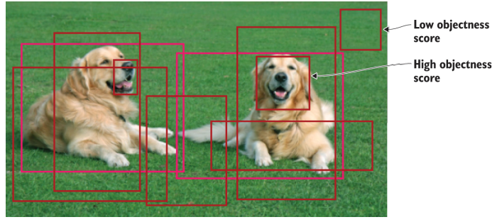
Region proposal
In this step, the system looks at the image and proposes regions of interest for further analysis.
The regions of interest (ROIs) are regions that the system believes that they have a high likelihood that they contain an object, called objectness score.
Regions with high objectness score are passed to the next steps whereas, regions with low score are abandoned.

Slide 7
Region proposal
There are several approaches to generate region proposals.
Originally, the ‘selective search’ algorithm was used to generate object proposals.
Other approaches use more complex visual features extracted by a deep neural network from the image to generate regions.
This step produces a lot of bounding boxes to be further analyzed and classified by the network.

Slide 8
Region proposal
During this step, the network analyzes these regions in the image and classifies each region into foreground (object) or a background (no object) based on their objectness score.
If the objectness score is above a certain threshold, then this region is considered a foreground and pushed forward in the network.
Note that this threshold is configurable based on your problem.

Slide 9
Region proposal
If the threshold is too low, your network will exhaustively generate all possible proposals and you will have better chances to detect all objects in the image.
On the flip side, this will be very computationally expensive and will slow down your detections.
So there is a trade-off that is made with region proposal generation is the number of regions vs. the computational complexity.

Slide 10
Network Predictions
This component includes the pretrained CNN network that is used for feature extraction to extract features from the input image that are representative for the task at hand and use these features to determine the class of the image.
In object detection frameworks, people typically use pretrained image classification models to extract visual features, as these tend to generalise fairly well.
For example, a model trained on the MS COCO or ImageNet dataset is able to extract fairly generic features.

Slide 11
Network Predictions
In this step, the network analyzes all the regions that have been identified with high likelihood of containing an object and makes two predictions for each region:
Bounding box prediction: the coordinates that locate the box surrounding the object. The bounding box coordinates are represented as the following tuple (x, y, w, h). Where the x and y are the coordinates of the center point of the bounding box and w and h are the width and height of the box.
Class prediction: this is the classic softmax function that predicts the class probability for each object

Slide 12
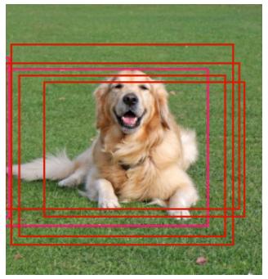
Network Predictions
Since there are thousands of regions proposed, each object will always have multiple bounding boxes surrounding it with the correct classification.
For example, take a look at the image of the dog in figure

Slide 13
Network Predictions
The network was clearly able to find the object (dog) and successfully classify it.
But the detection fired a total of five times because the dog was present in the 5 regions of interest produced in the previous step, hence the five bounding boxes around the dog in the figure.

Slide 14
Network Predictions
We just need one bounding box for each object for most problems.
Because what if we are building a system to count dogs in an image?
Our current system will count 5 dogs.
This is when the non-maximum suppression technique comes in handy.

Slide 15
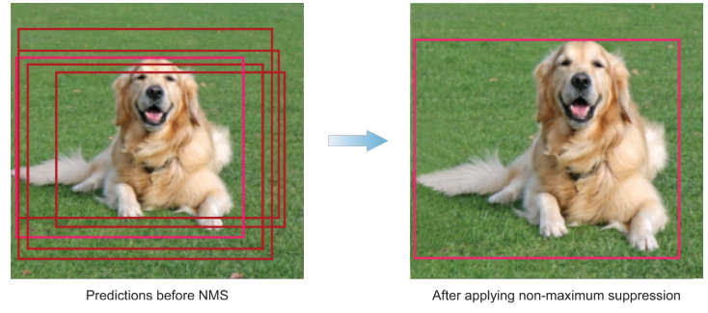
Non-maximum suppression (NMS)
Non-maximum suppression (NMS) is a technique that is used to make sure that the detection algorithm detects each object only once.
As the name implies, NMS technique looks at all the boxes surrounding an object to find the box that has the maximum prediction probabilities and suppress or eliminate the other boxes, hence the name, non-maximum suppression.

Slide 16
Non-maximum suppression (NMS)
The general idea of non-maximum suppression is to reduce the number of candidate boxes to only one bounding box for each object.
For example, if the object in the frame is fairly large and more than 2,000 object proposals have been generated, it is quite likely that some of these will have significant overlap with each other and the object.
Here is how the NMS algorithm works:

Slide 17
Non-maximum suppression (NMS)
Discard all bounding boxes that have predictions that are less than a certain threshold, called confidence threshold. This threshold is tunable. This means that the box will be suppressed if the prediction probability is less than the set threshold.
Look at all the remaining boxes and select the bounding box with the highest probability.

Slide 18
Non-maximum suppression (NMS)
Then calculate the overlap of the remaining boxes that have the same class prediction. Bounding boxes that have high overlap with each other and are predicting the same class are averaged together. This overlap metric is called Intersection Over Union (IOU).
The algorithm then suppresses any box that has an IOU value that is smaller than a certain threshold (called NMS threshold). Usually the NMS threshold is equal to 0.5 but it is tunable as well if you want to output less or more bounding boxes.

Slide 19
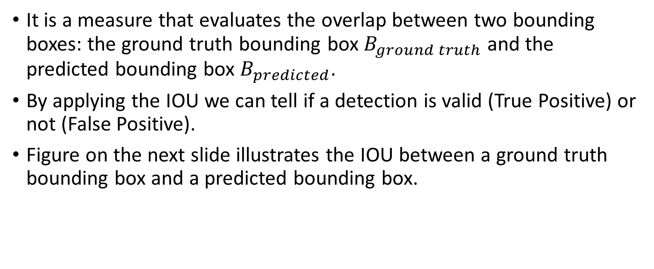
Intersection Over Union (IOU)
It is a measure that evaluates the overlap between two bounding boxes: the ground truth bounding box $B_{ground truth}$ and the predicted bounding box $B_{predicted}$.
By applying the IOU we can tell if a detection is valid (True Positive) or not (False Positive).
Figure on the next slide illustrates the IOU between a ground truth bounding box and a predicted bounding box.

Slide 20
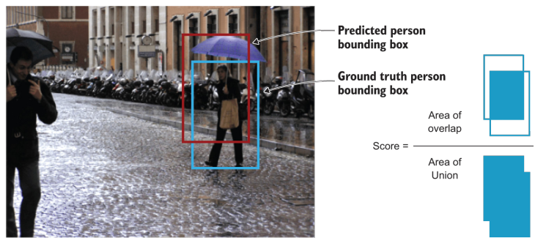
Intersection Over Union (IOU)

Slide 21
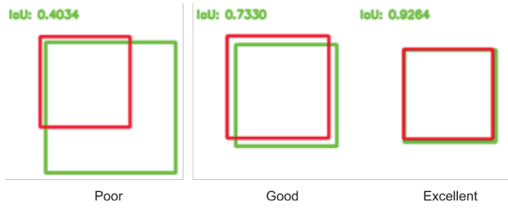
Intersection Over Union (IOU)
The intersection over the union value ranges from 0, meaning no overlap at all, to 1 which means that the two bounding boxes 100% overlap on each other.
The higher the overlap between the two bounding boxes (IOU value), the better.

Slide 22

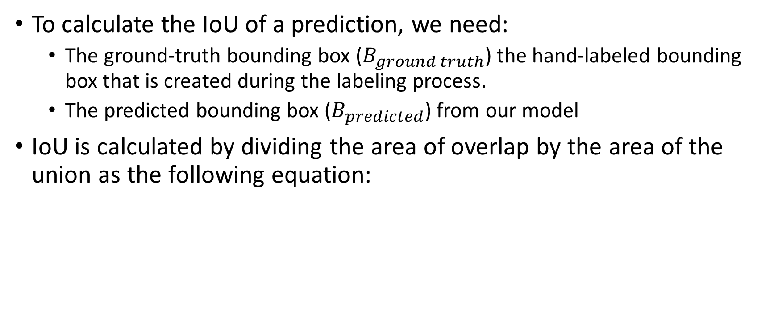
Intersection Over Union (IOU)
To calculate the IoU of a prediction, we need:
The ground-truth bounding box ($B_{ground truth}$) the hand-labeled bounding box that is created during the labeling process.
The predicted bounding box ($B_{predicted}$) from our model
IoU is calculated by dividing the area of overlap by the area of the union as the following equation:

Slide 23
Intersection Over Union (IOU)
IoU is used to define a “correct prediction”.
Meaning, a “correct” prediction (True Positive) is one that has IoU greater than some threshold.
This threshold is a tunable value depending on the challenge but 0.5 is a standard value.

Slide 24
Region-Based Convolutional Neural Networks (R-CNNs)
The Region-Based Convolutional Neural Networks (R-CNN) family of object detection techniques includes algorithms like R-CNN, Fast-RCNN, and Faster-RCNN.
The R-CNN model is comprised of four components:
Extract regions of interest (RoI)
Feature Extraction module
Classification module
Localization module

Slide 25
Extract regions of interest (RoI)
Also known as extracting region proposals.
These are regions that have a high probability of containing an object.
The way this is done is by using an algorithm, called Selective Search, to scan the input image to find regions that contain blobs and propose them as regions of interest to be processed by the next modules in the pipeline.

Slide 26
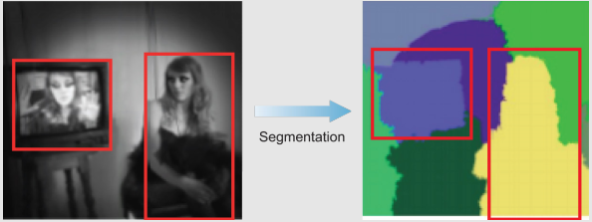
Extract regions of interest (RoI)
Selective Search
Selective search is an algorithm that is used to provide region proposals that potentially contain objects.
It tries to find the areas that might contain an object by combining similar pixels and textures into several rectangular boxes.
It applies a segmentation algorithm to find blobs in an image to figure out what could be an object.

Slide 27
Feature Extraction module
We either train a network from scratch which rarely happens or fine-tune a pretrained network.

Slide 28
Classification module
Train a classifier like Support Vector Machine (SVM), a traditional machine learning algorithm, to classify candidate detections based on the extracted features from the previous step.

Slide 29
Localization module
Also known as, bounding box regressor.
Machine learning problems are categorized as classification and regression problems.
Classification algorithms output a discrete, predefined classes (dog, cat, elephant) whereas regression algorithms output continuous value predictions.
In this module, we want to predict the location and size of the bounding box that surrounds the object.
The bounding box is represented by identifying four values: the x and y coordinates of the box’s origin (x, y), the width, and the height of the box (w, h).
Putting this together, the regressors predicts the four real-valued numbers that define the bounding box as the following tuple (x, y, w, h).

Slide 30
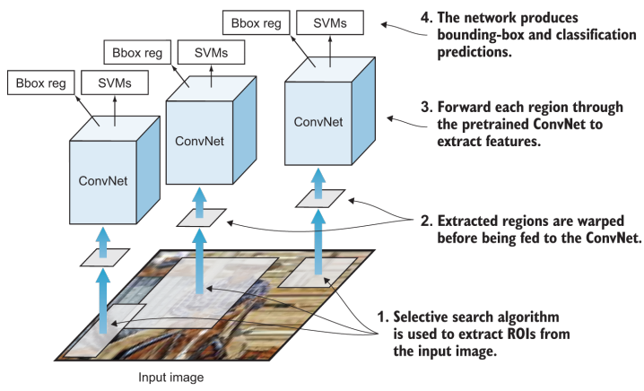
R-CNN

Slide 31
R-CNN - Disadvantages
Very slow object detection: selective search algorithm proposes about 2,000 regions of interest per a single image to be examined by the entire pipeline (CNN feature extractor + classifier).
It is very computationally expensive because it performs a ConvNet forward pass for each object proposal, without sharing computation.
Training is a multi-stage pipeline: as we discussed earlier, R-CNNs requires the training of three modules: CNN feature extractor, SVM classifier, and the bounding-box regressors.
This is why R-CNN is not a good fit for many applications, especially real-time applications that requires very fast inferences like self-driving cars.

